Slide 1



Notes:
Welcome. In this presentation, we will show how to install the Provengo tool and test the installation.

Slide 2
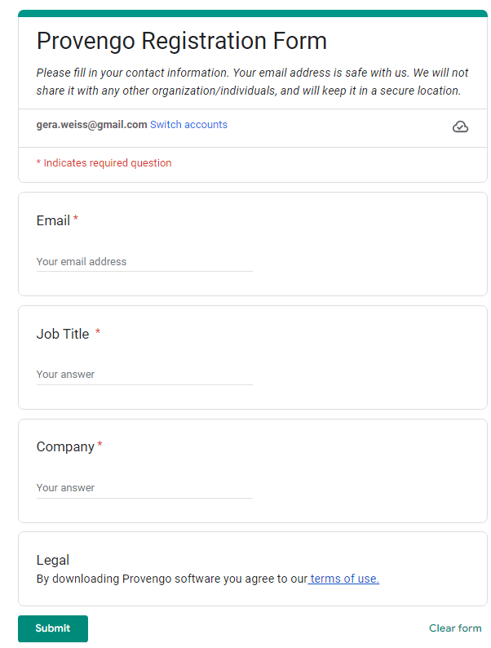
https://downloads.provengo.tech
Notes:
Navigate to the downloads page on the Provengo website. Fill in the required details and click the submit button.

Slide 3
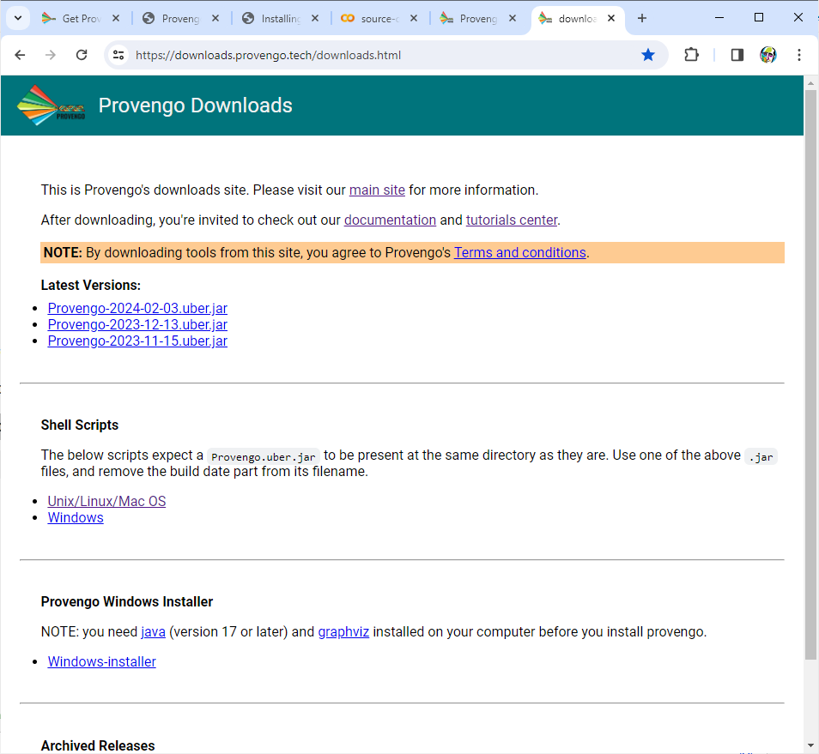
Notes:
You should now see the latest tool versions. Just click the link to download the required version.

Slide 4






Java $≥$ 17
sudo apt install default-jdk
Graphviz $≥$ 9
https://www.java.com/en/download/
sudo apt install graphviz
https://graphviz.org/download/
Selenium $≥$ 4.17
# Find the latest compatible version at https://chromedriver.chromium.org/
wget https://chromedriver.storage.googleapis.com/96.0.4664.45/chromedriver_linux64.zip
unzip chromedriver_linux64.zip
sudo mv chromedriver /usr/local/bin/chromedriver
# Find the latest jar in https://www.selenium.dev/downloads/
wget https://github.com/SeleniumHQ/selenium/releases/download/selenium-4.17.0/selenium-server-4.17.0.jar
java -jar selenium-server-4.17.0.jar standalone
Notes:
Before installing Provengo, ensure you have three key prerequisites.,,,
First is Java, the backbone of Provengo. Check if you have it by running "java dash-version" in your terminal. If not, head over to java.com to download the latest version.
Next, we need Graphviz. It visualizes your test scenarios. Find installation instructions for your operating system at graphviz.org.
Finally, don't forget Selenium Server. This lets Provengo control different web browsers. Installation options and official guides are available at selenium.dev.
We've included quick commands below, but taking a peek at the official guides is highly recommended.

Slide 5
wget -nc https://downloads.provengo.tech/releases/Provengo-2024-02-03.uber.jar \
-O /usr/local/bin/Provengo.uber.jar
wget -nc https://downloads.provengo.tech/shell-scripts/provengo.sh \
-O /usr/local/bin/Provengo
chmod +x /usr/local/bin/provengo
Notes:
To run the tool, you need to download the JAR file and the execution script to a directory on your path and set execution permissions for the script.

Slide 6
$ provengo
/\
/XX\
{XXXX#####################################
\XX/ / _ \_______ _ _____ ___ ___ ___
\/ / ___/ __/ _ \ |/ / -_) _ \/ _ \/ _ \
/_/ /_/ \___/___/\__/_//_/\_, /\___/
/___/
usage: provengo [-h] [--verbose] [--batch-mode] [--no-color] [--config CONFIG] [-p PROFILE] [-c [CUSTOM]] [-v]
{run,analyze,gen-scripts,gen-js,report,combi,sample,ensemble,gen-book,create} ...
provengo: error: too few arguments
[Main ] ERR Terminating because of previous errors. See logs.
[Main ] ERR 40 BadRequest
Notes:
If you have Java on your machine, running the provengo command should produce this text.

Slide 7
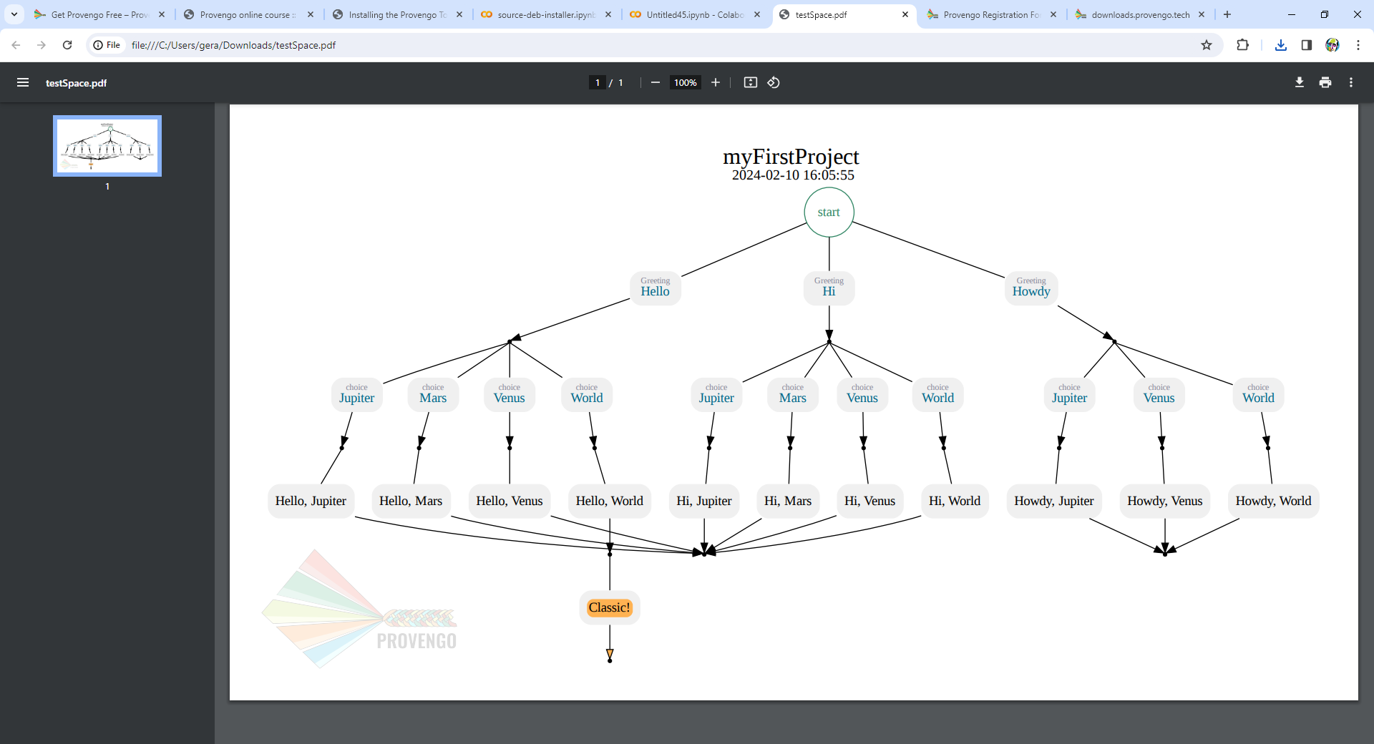
$ provengo --batch-mode create myFirstProject
/\
/XX\
{XXXX#####################################
\XX/ / _ \_______ _ _____ ___ ___ ___
\/ / ___/ __/ _ \ |/ / -_) _ \/ _ \/ _ \
/_/ /_/ \___/___/\__/_//_/\_, /\___/
/___/
[SETUP] INFO Project folder: /myFirstProject
$ provengo analyze -f pdf myFirstProject
/\
/XX\
{XXXX#####################################
\XX/ / _ \_______ _ _____ ___ ___ ___
\/ / ___/ __/ _ \ |/ / -_) _ \/ _ \/ _ \
/_/ /_/ \___/___/\__/_//_/\_, /\___/
/___/
[SETUP] INFO Input path: /myFirstProject
[ANLYZE] INFO Max DFS depth: defaulting to 60
[ANLYZE] INFO Found 19 states, connected by 26 edges.
/myFirstProject/products/run-source/testSpace.pdf
Notes:
If you have Graphviz on your machine, running these two commands should produce the test-space PDF file.

Slide 8
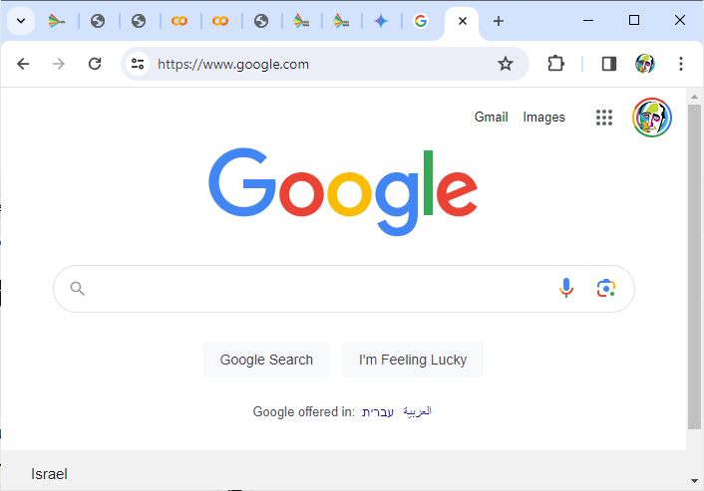
$ echo -e '// @provengo summon selenium\nbthread("", function () {new SeleniumSession().start("https://google.com")})' > myFirstProject/spec/js/hello-world.js
$ provengo run –-show myFirstProject
/\
/XX\
{XXXX#####################################
\XX/ / _ \_______ _ _____ ___ ___ ___
\/ / ___/ __/ _ \ |/ / -_) _ \/ _ \/ _ \
/_/ /_/ \___/___/\__/_//_/\_, /\___/
/___/
[SETUP] INFO Input path: /myFirstProject
[RUN ] INFO Preparing to run
[RUN>random] INFO B-program started
[RUN>random] INFO Selected: [StartSession [session= selectors=[https://google.com] ]]
Apr 10, 2024 7:08:24 PM org.openqa.selenium.remote.tracing.opentelemetry.OpenTelemetryTracer createTracer
INFO: Using OpenTelemetry for tracing
[RUN ] INFO Test Result: SUCCESS
Notes:
If you have Selenium server running on your machine, running these two commands should open Google’s web page.

Slide 9
Notes:
This concludes our presentation. We saw how to install Provengo and how to test the installation.

